Slide 1
ETL Framework
Marketing Systems-Data Engineering Team
February 05, 2021

Slide 2
Introduction to ETLFramework - Agenda
Overview
Architecture and Design
ETL Patterns
Pre-requisites and configuration
Typical Deployment Infrastructure
Demo and build an ETL
Introduction to Companion Tool (AutoETL)
Future Sessions
Q&A

Slide 3
Quickly Develop Multi source, Consistent and Easy to main ETL Jobs
Overview
Built on Scala and Spark technologies, provides a basic framework and utilities to enable development team to quickly develop complex, multi source, consistent and easy to maintain ETL jobs.
Main Features
Quick onboarding and setup
Rich set of prebuilt utility functions
Configurable
Multiple data sources
Security (currently support k8Secrets)
Highly Performing (Spark based)
Scalable
Continuously evolving
Online documentation and Onboarding support

Slide 4
Architecture and Design
ETL Jobs
Data Sources
ETL Framework
Data Sources
DB2
Initialize
DB2
Configuration Manager
Security Manager
Spark Session Manager
Netezza
Extract, Transform and Load)
Netezza
Spark SQL
Spark DataFrame
COS
Spark Writer
COS
Spark Reader
Spark Stream
Kafka
Spark Stream
Kafka
JDBC
Stocator
REST API
REST API
SFTP
Utilities
Scala-logging
Scala Test
SFTP
Config Tables:
Data Source
SQLs
Job History Log
Config DB
Logs

Slide 5
Technology Stack
Product | Versions | Comments
Apache Spark | 3.0.1 | Core
Spark SQL | 3.0.1 | Custom/AutoETL
Spark Hive | 3.0.1
Scala | 2.12.10 | Supported Programming Language
JDBC |  | DB specific versions
Stocator | 1.1.3 | High Performance COS Operations
ScalaTest | 3.2.3 | Unit Test Framework
jUnit | 4.12 | Unit Test Framework
ConfigurationManager | 1.3.4 | Configuation Manager
log4j | 2.12.1 | Logging
scala-logging | 3.9.2 | Logging
HttpClient | 4.5.9 | Rest API
Kafka Clients | 2.6.0 | Supports Kafka Streaming
Spark Streaming | 3.0.1 | Supports Data Streaming
k8sSecrts |  | Secures sensitive data
Infrastructure Product | Comments
Kubernetes/OpenShift | Containerized workloads and services
LogDNA | Logs
Apache Airflow/Argo | Job Orchestration
DB2/DB2WoC | Data Source/Sinc (single and multi paritions)
Netezza | Limited suport
Cloud Object Storage (COS) | Storage (CSV and Parquet)
SFTP | Read and writen flat files
Kafka (WIP) | Data Stream Support
Kafka Connectors (WIP) | Debezium, API Connector, DBSource

Slide 6
ETL Patterns
Config DB
Jobs Config
Data Sinks
Custom ETL Jobs
(Custom Code)
Custom ETL Jobs
(Kafka Steam)
AutoETL
(No Custom code)
DB2
Data Sources
DB2
ETL Framework
Initialize
Netezza
Netezza
Configuration Manager
Security Manager
Spark Session Manager
COS
Extract, Transform and Load)
Spark DataFrame
COS
SFTP
Spark SQL
Spark Writer
Spark Reader
Spark Stream
Data Sources
Kafka
DB2
Spark Stream
Kafka
JDBC
Netezza
Stocator
REST API
Apps
COS
Utilities
Scala-logging
Scala Test
REST API
SFTP
Config Tables:
Data Source
SQLs
Job History Log
Pattern 1 – Custom Batch Jobs
Config DB
Logs
Pattern 2 – Custom Stream Jobs
Pattern 3 – Config based batch Jobs

Slide 7
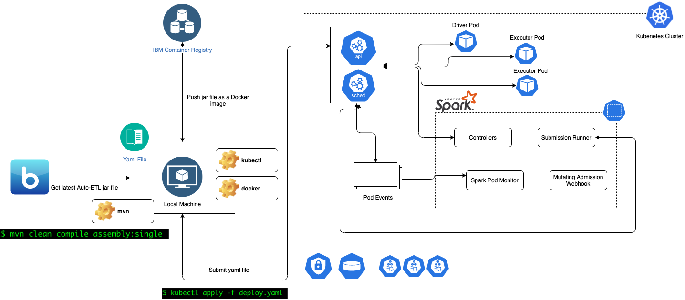
Deployment Architecture

Slide 8
Pre-requisites Other Information
ETLFramework will be provided as a jar file
app.conf – Store application specific configuration data
Requires following tables:
ETL_DATA_SOURCES - Stores connection details
ETL_JOB_HIST - Stores job history log
ETL_JOB_SQL - Stores SQLs to be used in ETL Jobs (Optional table)
spark-conf.properties
log4j.properties
Order of evaluation of properties:
Arguments passed by ETL jobs
Application provided (in conf and properties files)
Framework default
k8sSecret for protecting credentials

Slide 9
Demo
Let us build a simple ETL job

Slide 10
Upcoming Sessions
AutoETL
Built on ETLFrameWork, this companion tool enables data engineers/users to transform and/or transfer data between systems through configuration rather than developing custom code.
DataStage Primer – Session 2

Slide 11
Upcoming Brown Bag Sessions

Slide 12
Backup

Slide 13
Questions

Slide 14
Delta Data Load Using CDC (WIP)
RDBMS
Consumers
RDBMS
RDBMS
Incremental changes
(Kafka Connector)
COS
Transformed Dimension
COS
Kafka
Revenue Data
Rest API
Incremental changes
(Kafka Connector)
ETL Framework
Spark Stream
RDBMS
RDBMS
RDBMS
14

Slide 15
High Performance Data Load and Unload–(In Planning)
HPU SFTP
(Server)
RDBMS
RDBMS
RDBMS
COS
Transformed Dimension
Unload request
CSV Files
Migration Utility
Read CSVs
Repartitions them
Write
RDBMS
RDBMS
RDBMS
With
HPU
Data
Unload request
RDBMS
RDBMS
RDBMS
15

Slide 16
(Near) Real Time Data Load
RDBMS
RDBMS
RDBMS
CDC Tool
Incremental changes
RDBMS
RDBMS
RDBMS
16

Slide 17
ETL Framework - Motivation
Integrate ISAP into CEDP Platform
EDS and Enterprise Taxonomy compliance
Integrate with EPM for Dimension, revenue and signings data
Migrate ETLs from DataStage to Spark based planform
Eliminate/minimize code changes

